Slide 1



BG6
PVN
SOFTWARE TEAM REPORT
Dept: (PVN)Business Group 6-PVN1 Factory-FME Dept.-Automation Sec.
Team: Software
Date: 2025/02/20
FME
BG6 PVN

Slide 2

SOFTWARE TEAM
TASK WORK
PROJECT STATUS
FME
BG6 PVN

Slide 3



TRAN THI PHUONG - V23005558 - IDL
Responsible for monitoring the status of all AOI stations, training AOI for new members
Knowledges about Basic Python language
SOFTWARE
TEAM
MEMBERS
THAN NGOC LONG - V24002407 - IDL
Responsible for debugging, training model for the AOI station
Knowledges about JavaScript, C++, C, Python, MySQL, MongoDB
NGUYEN HOANG GIANG - V24002752 - IDL
Responsible for debugging, training model for the AOI station
Knowledges about Python language
NGUYEN TRUNG NHAN - V24002752 - IDL
Responsible for debugging, training model for the AOI station
Knowledges about Python language
FME
BG6 PVN

Slide 4
NGUYEN TUNG LONG - V24001835 - DL
Responsible for monitoring the status of all AOI stations, training AOI for new members
Knowledges about Basic Python language
SOFTWARE
TEAM
MEMBERS
HOANG DUC TRINH - V24001982 - DL
Learning debugging, training model for the AOI stations nightshift
BUI THI UYEN - V24004286 - DL
Learning training model in Cambrain system
Follow up AOI station status
FME
BG6 PVN

Slide 5
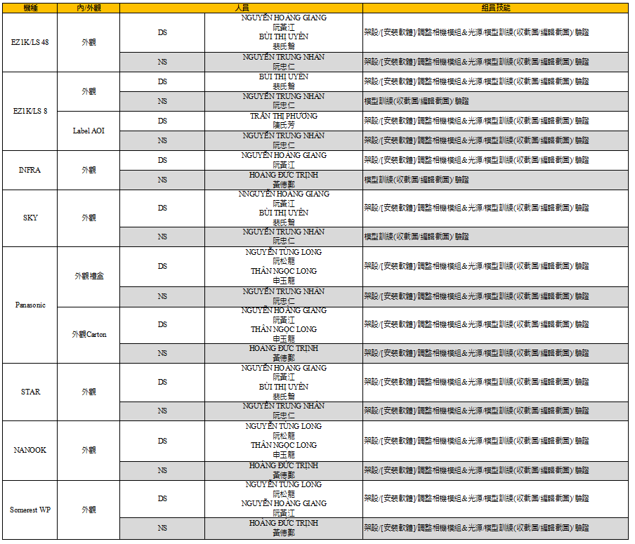

TASK
WORK EACH
MEMBER
FME
BG6 PVN

Slide 6
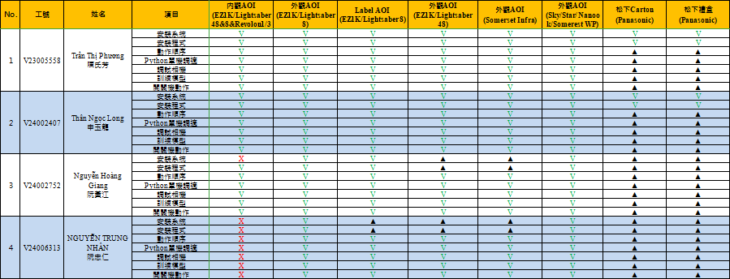
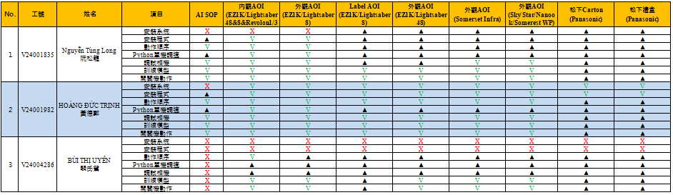
TASK
WORK EACH
MEMBER
V=已學習
▲=學習中
X=未學習
NA=設備無此功能
FME
BG6 PVN

Slide 7

FME
BG6 PVN

Slide 8
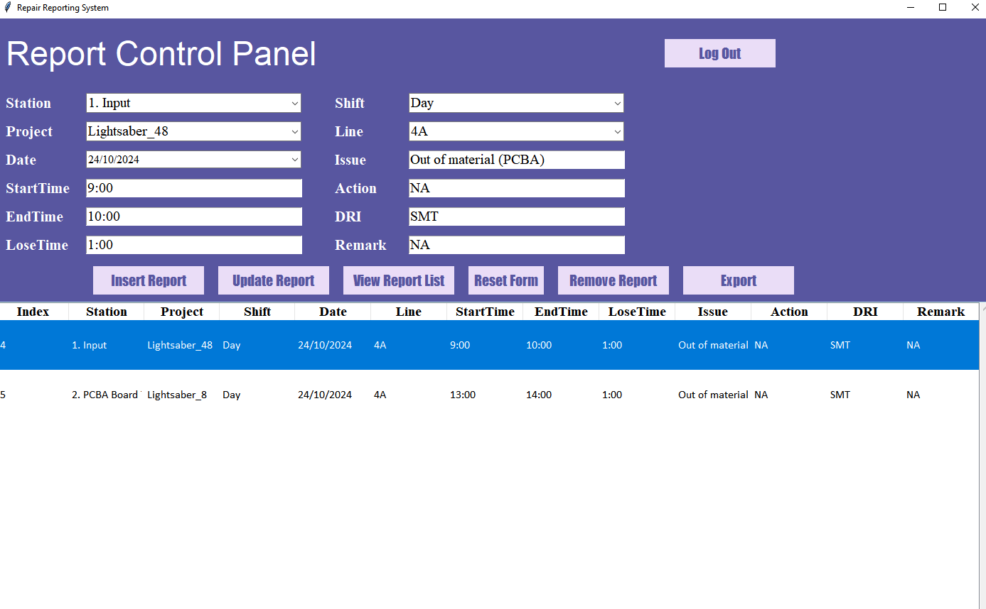
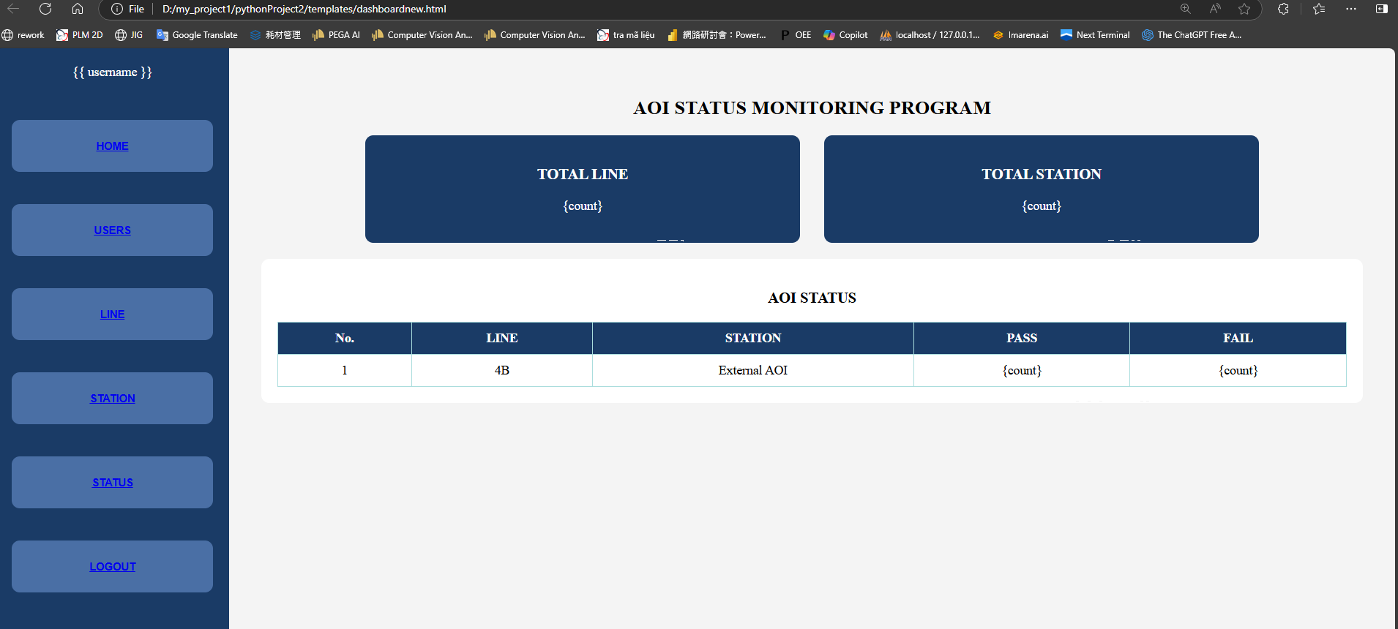
MAINTENANCE REPORTING SYSTEM(M.R.S.)
BG6
PVN
STATUS of AOI MONITORING PROGRAM (S.A.M.P.)
FME
BG6 PVN

Slide 9
CONCEPT FOR MAINTENANCE REPORTING SYSTEM(M.R.S.)
Station A
UI tool
Update data
SQLite by HTTP protocol
PC Database (Sqlite3)
Get data from client and update to database
(SERVER)
Station B
UI tool
Get data from UI: “station, project, date, start time, endtime, lost, time, shift, line, issue, action, DRI, remart”
UI tool
SQL query
by HTTP
Station C
Station n
UI tool
DASH BOARD 1
DASH BOARD 2
DASH BOARD n
OEE webservice
tool to parsing data and send to server
CLIENTs

Slide 10

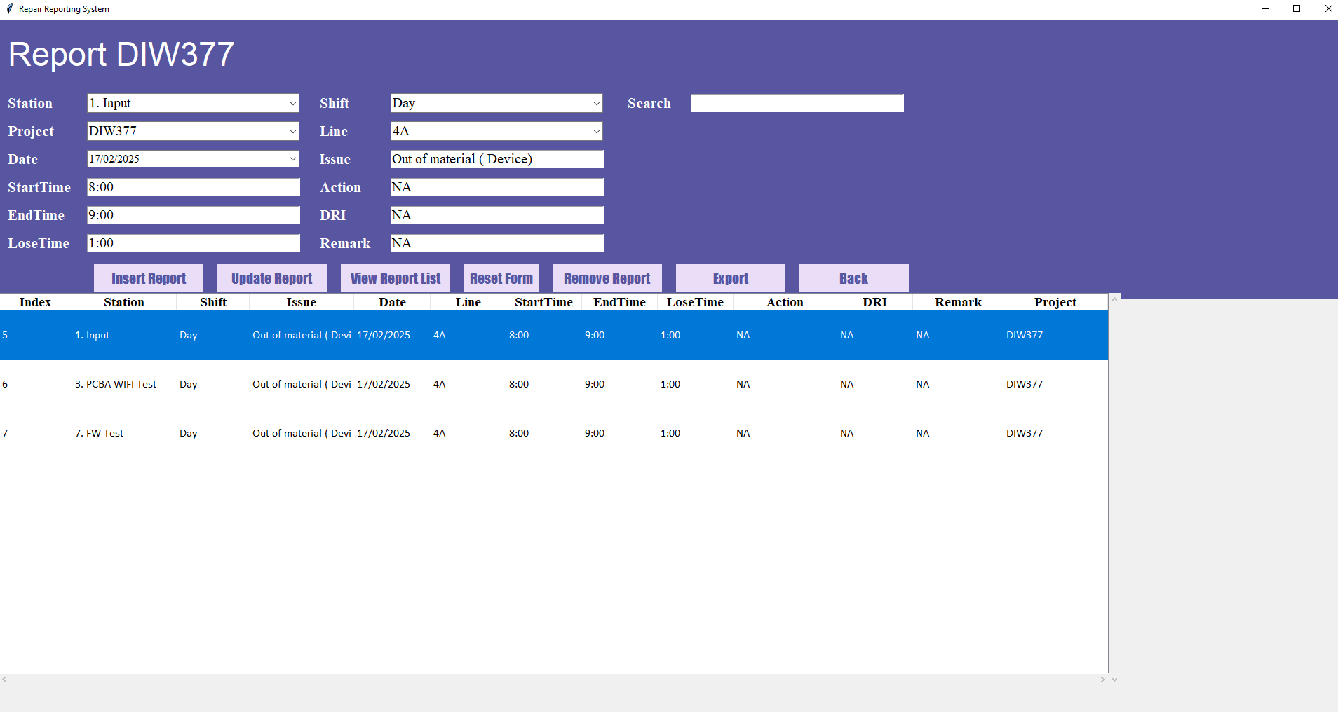
MAINTENANCE REPORTING SYSTEM(M.R.S.)
Fill in information
Export data as excel file
Using Python's Tkinter library for GUI (图形用户界面Graphical User Interface）development and SQLite for database management
Purpose: Manage repair reports data through an interactive user interface
View Report List
FME
BG6 PVN

Slide 11
CONCEPT FOR STATUS of AOI MONITORING PROGRAM (S.A.M.P.)
AOI 1
Data processing tool
PC Database (Sqlite3)
Get data CSV from FTP and update to database
AOI 2
Data processing tool
FTP SERVER
10.177.yyy.XXX
SQL query
by HTTP
AOI 3
Data processing tool
Images, test logs
AOI n
Data processing tool
DASH BOARD 1
DASH BOARD 2
DASH BOARD n
LOCAL DATA FROM AOI TOOL

Slide 12
STATUS of AOI MONITORING PROGRAM (S.A.M.P.) STEPS
01
Change the website interface template
Maintain to manage MySQL data
02
Build a server to connect to AOI stations
04
03
Edit the code on AOI stations
05
Run test and fix error code

Slide 13
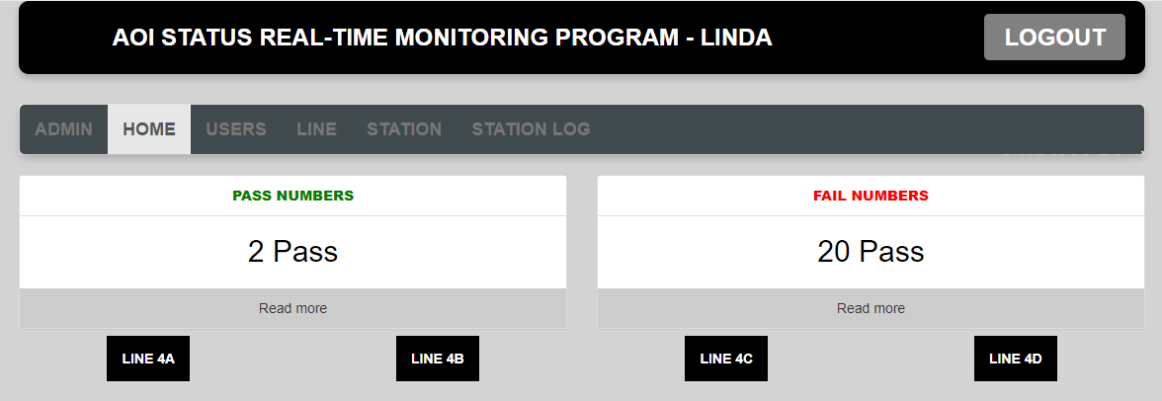
Change the website interface template

Slide 14
Admin
STATUS of AOI MONITORING PROGRAM (S.A.M.P.)
HOME
TOTAL LINE
{count}
TOTAL STATION
{count}
USERS
AOI STATUS
NO. | LINE | STATION | PASS | FAIL
1 | 4B | Outernal AOI | {count} | {count}
LINE
STATION
STATUS

Slide 15
Admin
STATUS of AOI MONITORING PROGRAM (S.A.M.P.)
HOME
AOI STATUS
NO. | USER | PASSWORD | ROLE | FUNCTION
1 | 4B | Outernal AOI | {count} | {count}
USERS
LINE
STATION
STATUS

Slide 16
Admin
STATUS of AOI MONITORING PROGRAM (S.A.M.P.)
AOI LINE
NO. | LINE | STATION | PASS | FAIL
1 | 4B | Outernal AOI | {count} | {count}
HOME
USERS
LINE
STATION
STATUS

Slide 17
Admin
STATUS of AOI MONITORING PROGRAM (S.A.M.P.)
AOI STATION
NO. | STATION | MODEL | PASS | FAIL
1 | 4B | Outernal AOI | {count} | {count}
HOME
USERS
LINE
STATION
STATUS

Slide 18
Admin
STATUS of AOI MONITORING PROGRAM (S.A.M.P.)
AOI STATUS
NO. | LINE | STATION | PASS | FAIL
1 | 4B | Outernal AOI | {count} | {count}
HOME
USERS
LINE
STATION
STATUS

Slide 19
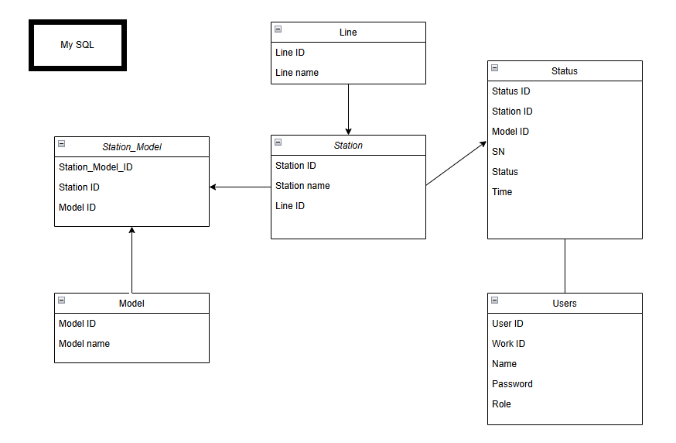
Maintain to manage MySQL data
Change the way to manage MySQL data

Slide 20

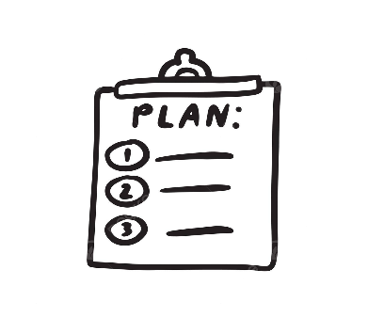
FUTURE PLAN
By Software Team
Continue to develop and train models for new models at AOI stations
Develop and improve software projects:
MAINTENANCE REPORTING SYSTEM(M.R.S.)
STATUS of AOI MONITORING PROGRAM (S.A.M.P.)

Slide 21

THANK YOU!

